Slide 1


Modeling Exercise Relationships: A Unified Approach
Haw-Shiuan Chang, Hwai-Jung Hsu, Kuan-Ta Chen
Institute of Information Science,
Academia Sinica, Taipei, Taiwan

Slide 2


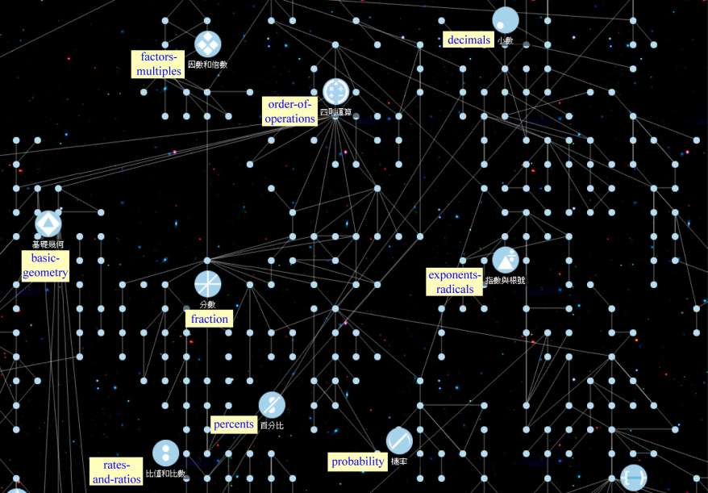




Prerequisite links
1+5=?
40-5=?
addition
subtraction
35+10-2=?
Knowledge map
addition-and-subtraction
Exercise Relationships
Adaptive Test

Slide 3
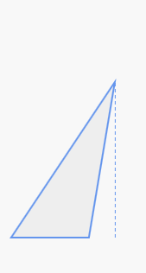
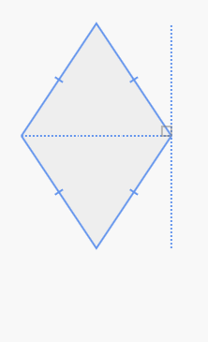
Data:
low cost
fast
unstable
Khan
(now)
Khan
(before)
Expert:
expensive
transparent
robust
Extracting
(40 d)
Features
Problem Log:
Ours
Knowledge Map
Answering accuracy
Prerequisite links
Student modeling
Exercise titles ...
#Records…
Regression
Semantic Gap
Difficulty?
Prerequisite?
Similarity?
Labels
Area?
Area?
(3 d)
7
3
VS
8
Crowd-sourcing
A
B
6
12

Slide 4
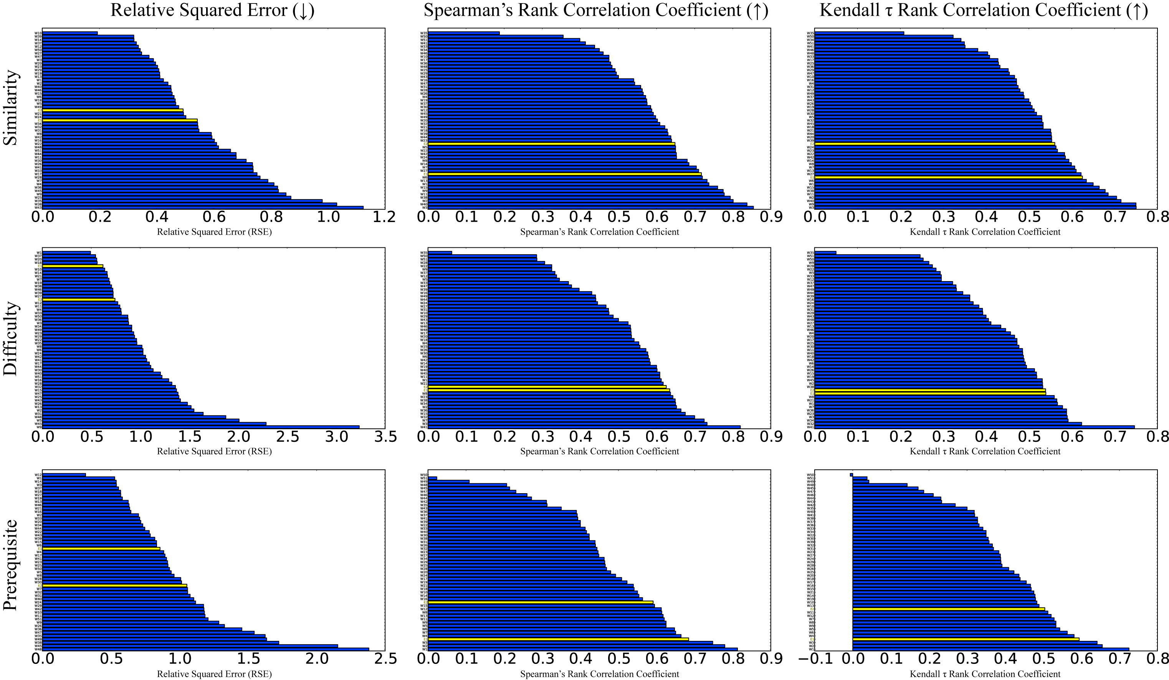
Evaluation by Rank Correlation
Workers
Teachers
Expert-driven
Ours
Data-driven
Similarity
Better
Difficulty
Prerequisite

Slide 5
Adaptive testing (on going)
Similarity
Prerequisite
Correct
More difficult
Student ability
Similar
Wrong
Difficulty

Slide 6
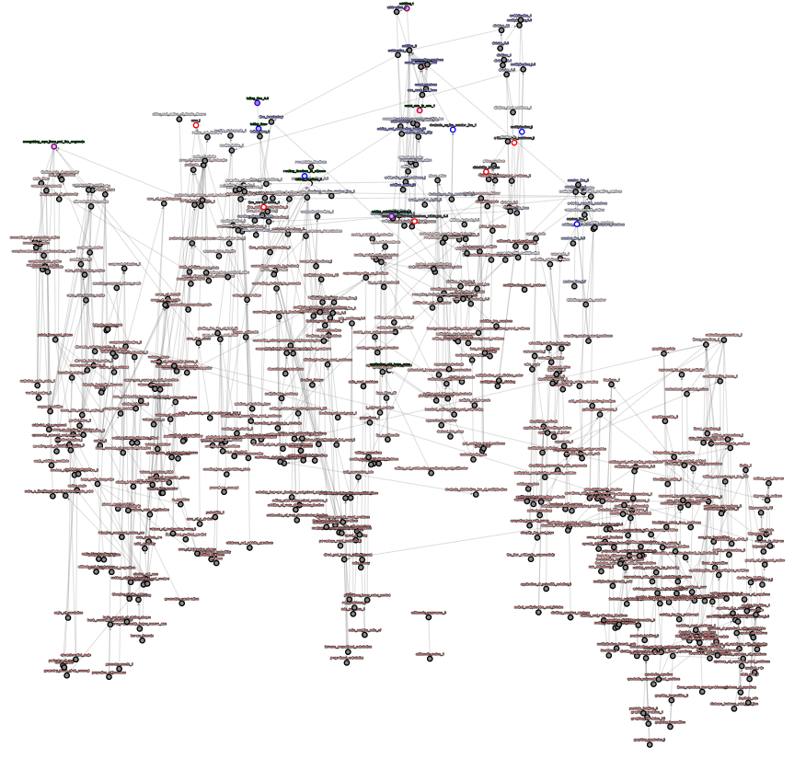
Adaptive testing (on going)
Arithmetic
Geometry
Algebra
All codes and demos will be available in the future

Slide 7
Advantage summary
Low-priced
Label only 2% of pairs
We cost only 1,000 USD
Simple
Skip many troubles
Defining skills,
Discover Q-matrix,
Handling skill prerequisite,
Modeling by BKT or IRT
Transparent, Flexible
Fast
Effective
Quantifiable performance
General
Still work well
with less data
even if each student is hard to be modelled
Sparse observation
Freedom of choosing exercises

Slide 8



Junyi
A c a d e m y
PSLC DataShop
a data analysis service for the learning science community

Slide 9
Q & A

Slide 10
Appendix

Slide 11
Learning from humans
Noise would be canceled out when #workers is large enough
Several quality control methods are applied in our case
Difficulty labels are highly correlated to the parameters estimated by IRT [1]
Learn from the best we can get now
Popular e-learning platform often still use human annotation to organize items
Not perfect, but few errors in ground truth is acceptable in the research using supervised learning.
[1] K. Wauters, P. Desmet, and W. van den Noortgate. Acquiring item difficulty estimates: a collaborative effort of data and judgment. In EDM, 2011

Slide 12
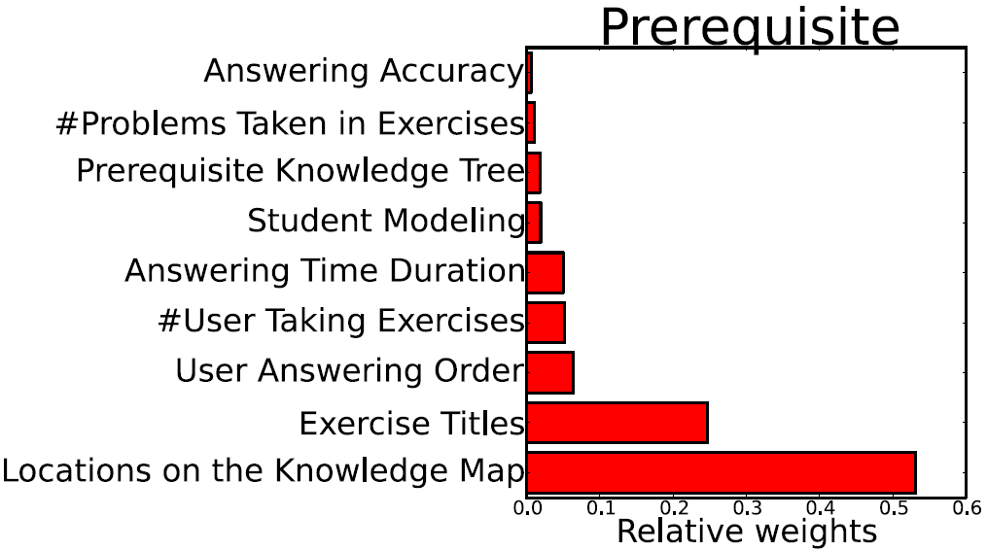
Feature Importance

Slide 13
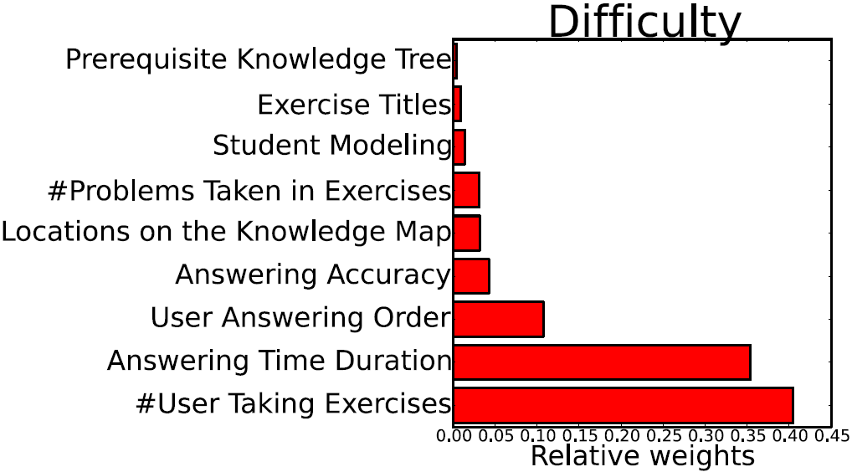
Feature Importance

Slide 14
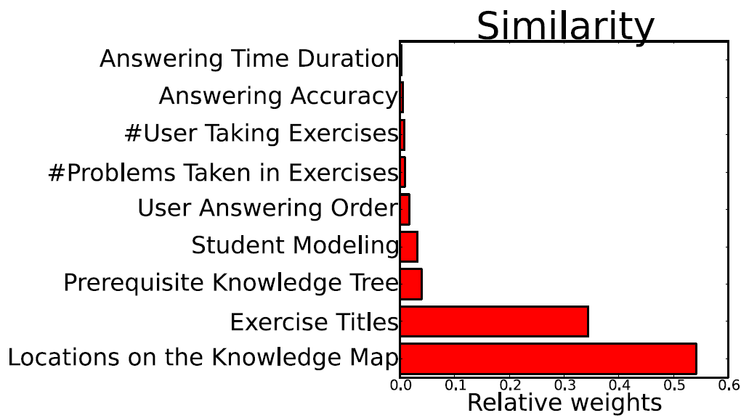
Feature Importance

Slide 15
Evaluation
Relative Square Error (↓)
Predicted difficulties
Closer to crowd consensus
Compare with humans
Under different metrics
ρ Rank Correlation (↑)
τ Rank Correlation (↑)

Slide 16

# Registered users:
69,800
# Hours for videos
29,517
# Hours for exercises
79,201
2012/10 ~ 2014/08
(The numbers double now)
Junyi
Focus on
A c a d e m y

Slide 17
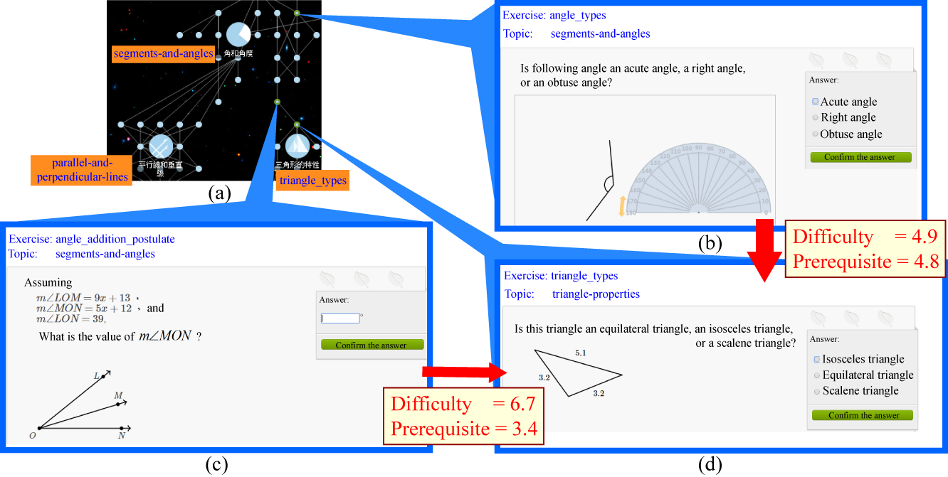
An Example

Slide 18
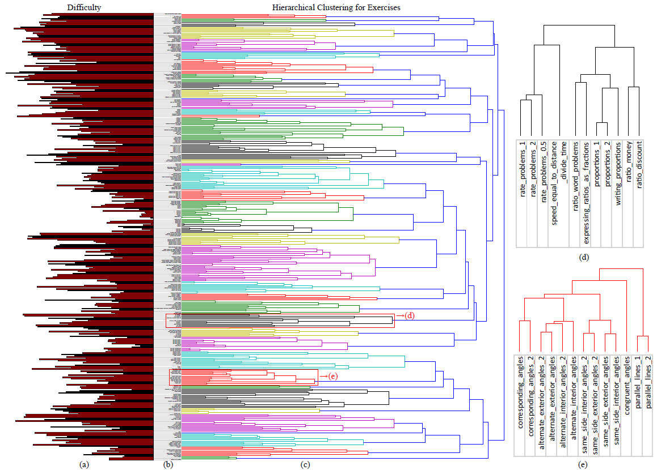
Application for Teachers
Algebra
Geometry

Slide 19
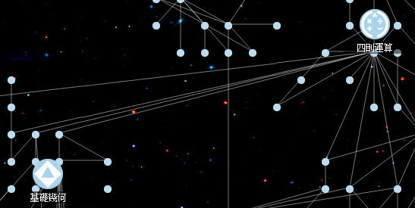
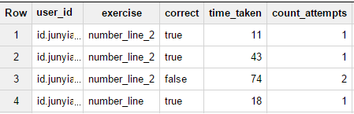
Collecting Data
Problem Log
Exercise Information
Parent?
Distance?
Answering accuracy
#User taking exercises
User answering order Answering time duration
……
Structure on knowledge map
area_of_triangles
area_of_rhombi
Distance between titles

Slide 20


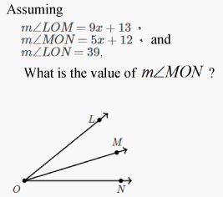
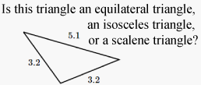
Student modeling?
X
After 10 days
O
O
After 3 days
X

Slide 21
Too many hidden variables!
Arithmetic
Algebra
Geometry
Student Ability
Arithmetic
Algebra
Geometry
…
0.1
0.1
0.2
X
10 days
0.1
0.5
0.2
O
0.8
0.7
0.1
O
3 days
0.6
0.7
0.1
X
…
…
Arithmetic
Algebra
Geometry
Exercise Difficulties
Arithmetic
Algebra
Geometry
0.7
0.7
0.1
…
0
0
0.2
…

